Slide 1

Median & Order Statistics
Guidance: Professor Jesus A. Gonzalez
Presented By:
Balaji Gurumoorthy
Revathy Ramamoorthy
Tharoon T Thiagarajan
Pavithra Rathinasabapathy
Goutami Padmanabhan

Slide 2

Order Statistics
Selection Problem
Finding Minimum
Minimum and Maximum
Selection in Expected Linear Time
Randomized-Select Procedure
Best, Worst Case & Average Case
Selection in Worst Case Linear Time
Time Complexity
Overview

Slide 3

Order Statistics
The i’th Order Statistic
The ith order statistic of a set of n elements is the ith smallest element.
The minimum is the first order statistic (i =1).
The maximum is the nth order statistic (i = n).
A median is the “halfway point” of the set.

Slide 4
Order Statistics
The i’th Order Statistic
When n is odd, the median is unique, at i = (n + 1)/2.
When n is even, there are two medians:
The lower median: i = ⎣(n + 1)/2⎦
The upper median: i = ⎡(n + 1)/2⎤.
Lower median - > “the median”.

Slide 5

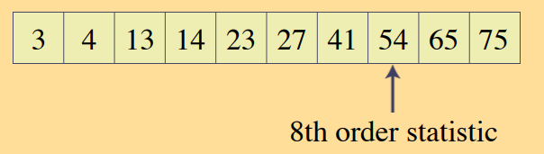
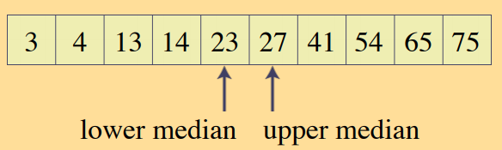
Order Statistics
The ith Order Statistic
Note: If n is odd, lower and upper median are the same

Slide 6
Selection Problem
How to find ith Order Statistic
Goal
To find the ith order statistic and its running time?
Input: A set A of n (distinct) number and a number i, with 1 ≤ i ≤ n.
Output: The element x ∈ A that is larger than exactly i–1 other elements of A.

Slide 7
Selection Problem
How to find ith Order Statistic
Procedure
The selection problem can be solved in O ( nlg n ) time.
Sort the numbers using an O(nlg n)‐time algorithm, such as heapsort or merge sort.
Then return the ith element in the sorted array.
Faster Algorithm with O(n) running time will be presented here

Slide 8
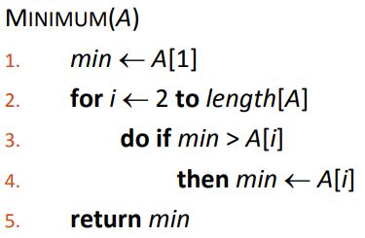
Finding The Minimum
Upper bound of n−1
Examine each element
Keep track of the smallest one.
Algorithm is optimal. Why?
Because each element, except the minimum, must be compared to a smaller element at least once.
The maximum can be found: How?
By Replacing the > with < in the above algorithm.

Slide 9
Simultaneous Minimum & Maximum
Steps:
Process elements in pairs.
Compare the elements of a pair to each other.
Compare the larger element to the maximum so far.
Compare the smaller element to the minimum so far.
Leads to only 3 comparisons for every 2 elements.
Find the Min and Max independently:
Using n–1 comparisons for each, for a total of 2 n–2 comparisons.
Utmost 3 ⎣ n/2 ⎦ comparisons are needed:
Maintain the min and max of elements seen so far.

Slide 10
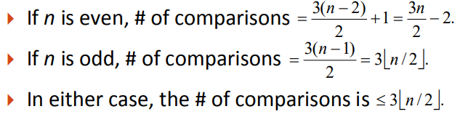
Simultaneous Minimum & Maximum
No of Comparisons:
Setting initial values for min and max depends on whether n is odd or even.
If n is even:
Compare first two elements and assign larger to max and smaller to min.
If n is odd:
Set both min and max to the first element.

Slide 11
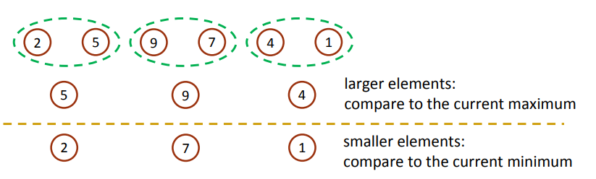
Simultaneous Minimum & Maximum
Observation:
Comparing the elements of a pair to each other:
Larger can’t be the minimum & smaller can’t be the maximum.
Compare the larger to the current maximum and smaller to the current minimum.
It costs 3 comparisons for every 2 elements.
The previous method costs 2 comparisons for each element.

Slide 12
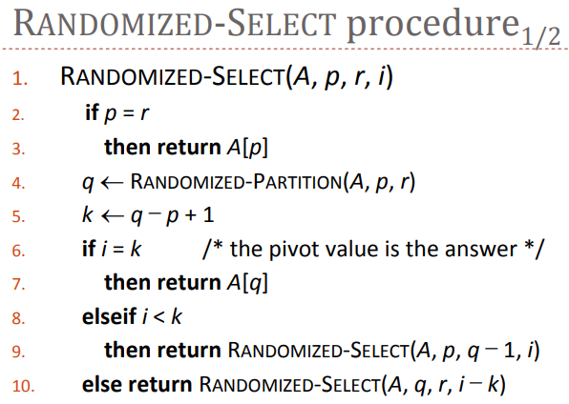
Selection in Expected Linear Time
Selection of the ith smallest element of the array A can be done in Θ(n) time.
Randomized version in this section.
RANDOMIZED ‐ SELECT:
Is a divide ‐and ‐conquer algorithm.
uses RANDOMIZED ‐ PARTITION.
Recurses on one side of the partition only.

Slide 13
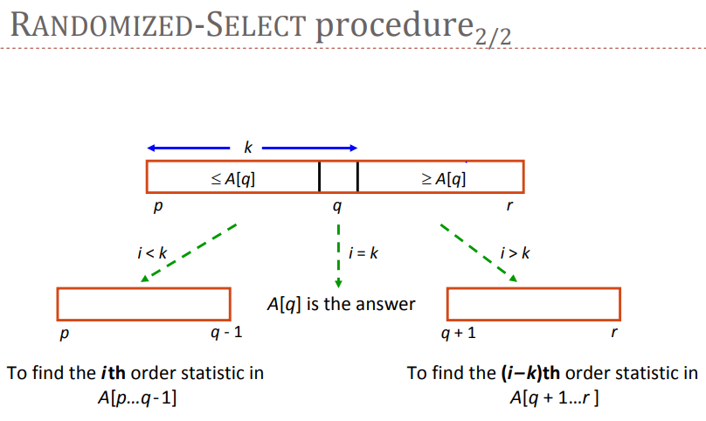
Randomized-Select Procedure - Explained

Slide 14
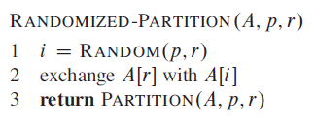
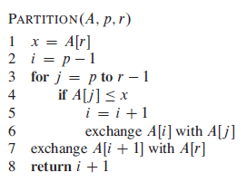
Randomized-Partition & Partition Functions:
Time Complexity: Θ(n)
Time Complexity: Θ(n)

Slide 15
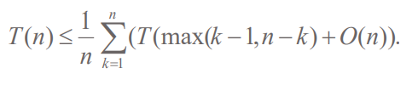
Best, Worst & Average Case
Worst Case: Recurse Subarray that is only 1 element smaller than the previous subarray.
T(n) = T(n – 1) + Θ(n) = Θ(n 2)
Best Case: Recurse subarray that has half of the elements smaller than the previous subarray.
T(n) = T(n/2 ) + Θ(n) = Θ(n)
(Master Theorem, case 3)`
Average Case:
We will show that T(n) = Θ(n).
For 1 ≤ k ≤ n, the probability that the subarray A[p .. q] has k elements is 1/ n.
To obtain an upper bound, we assume that T(n) is monotonically increasing and that the ith smallest element is always in the larger subarray.

Slide 16
Algorithm Analysis
If n is even, each term from
T( ⎡n/2⎤ ) to T(n – 1) appears exactly twice.
If n is odd, each term from
T( ⎡n/2⎤ ) to T(n – 1) appears exactly twice and
T( ⎣n/2⎦ ) appears once.
Because k = ⎡n/2⎤, k – 1= n – k = ⎣n/2⎦
Now Solving the below recurrence by substitution method in next slide,

Slide 17
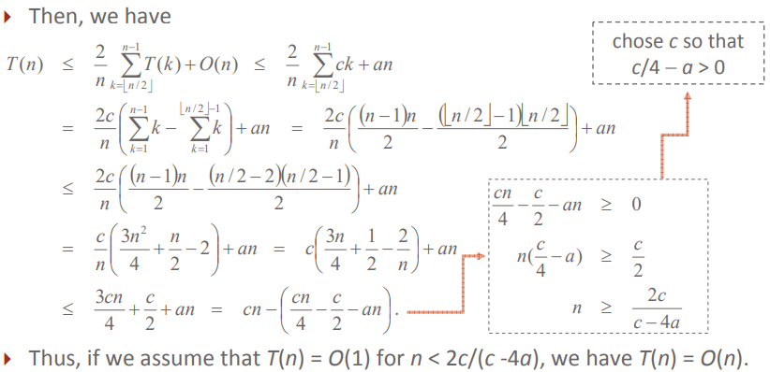
Algorithm Analysis
Solve this recurrence by substitution:
Assume T(n) ≤ cn for sufficiently large c.
The function described by the O(n) term is bounded by cn for all n > 0.

Slide 18
Selection in Worst-Case Linear Time
Idea: Guarantee a good split when the array is partitioned.
SELECT algorithm:
1. Divide n elements into groups of 5 elements.
2. Median of each of the ⎡n/5⎤ groups - Insertion sort - Pick the median from each group.
3. Use SELECT recursively to find median x of the ⎡n/5⎤ medians.
4. Partition n elements around x. (kth element of the array) after partitioning.
k −1 elements -> low side
n − k elements -> high side.

Slide 19
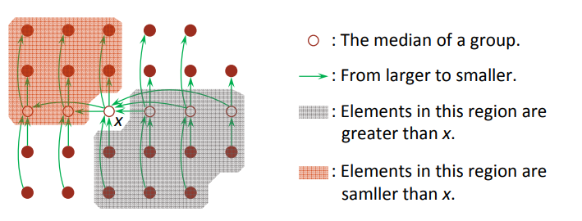
Selection in Worst-Case Linear Time
5. Now there are three possibilities:
If i = k, then return x.
If i < k, then use SELECT recursively to find ith smallest element on the low side.
If i > k, then use SELECT recursively to find (i−k)th smallest element on the high side.

Slide 20
Time Complexity
SELECT Algorithm
Divide n elements into groups of 5 elements | Find median of each of the ⎡n/5⎤ groups. | Use SELECT recursively to find median x of the ⎡n/5⎤ medians. | Partition the n elements around x | For three possibilities:
O(n) | O(n) | T( ⎡n/5⎤ ) | O(n) | T(7n/10 + 6)
Time complexity: T(n) ≤ T( ⎡n/5⎤ ) + T(7n/10 + 6) + O(n)
Solving this recurrence by Substitution: Time complexity: T(n) ≤ cn => O(n)

Slide 21

Summary
Selection Problem
Minimum & Maximum
Selection – RANDOMIZED-SELECT
Time Complexity

Slide 22
References:
Introduction To Algorithms, 3rd Edition,
By Thomas H. Cormen, Charles E. Leiserson, Ronald L. Rivest &
Clifford Stein
Page No: 213 - 219

Slide 23
Thank You.

